Slide 1

Building Your Own Interactive Live Streaming App
Red5 Pro Presentation - DigitalOcean
Infrared5 Confidential Information subject to Non-Disclosure Agreement by and between Infrared5 and Recipient

Slide 2

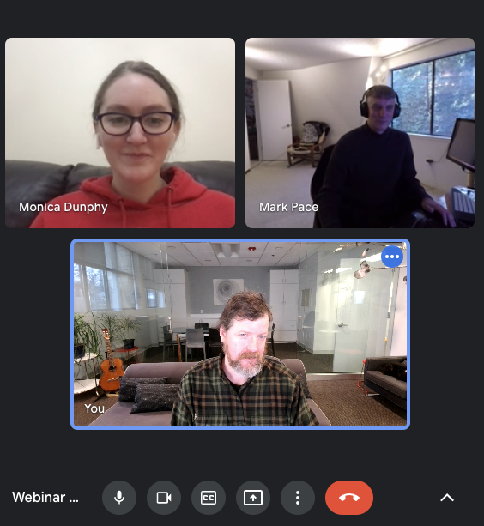
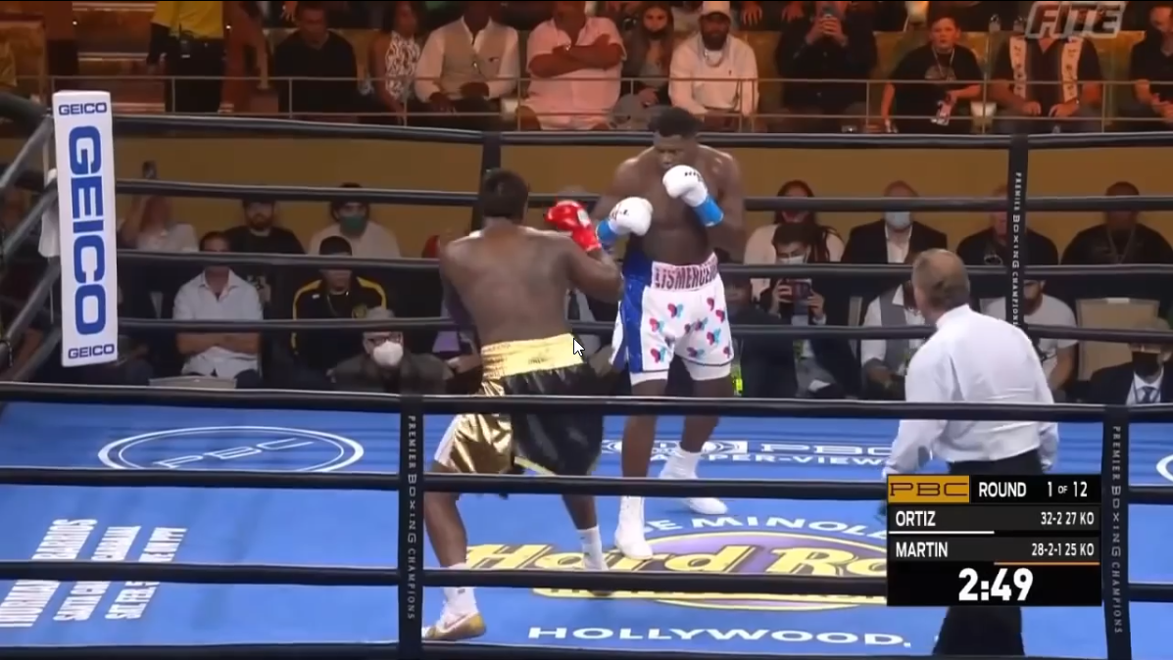
/ What is a Virtual Watch Party?
Video Chat
+
Main Program
Red5 Pro Presentation - DigitalOcean
Infrared5 Confidential Information subject to Non-Disclosure Agreement by and between Infrared5 and Recipient
Notes:
Multi-party communication while viewing a show, movie, match, etc

Slide 3
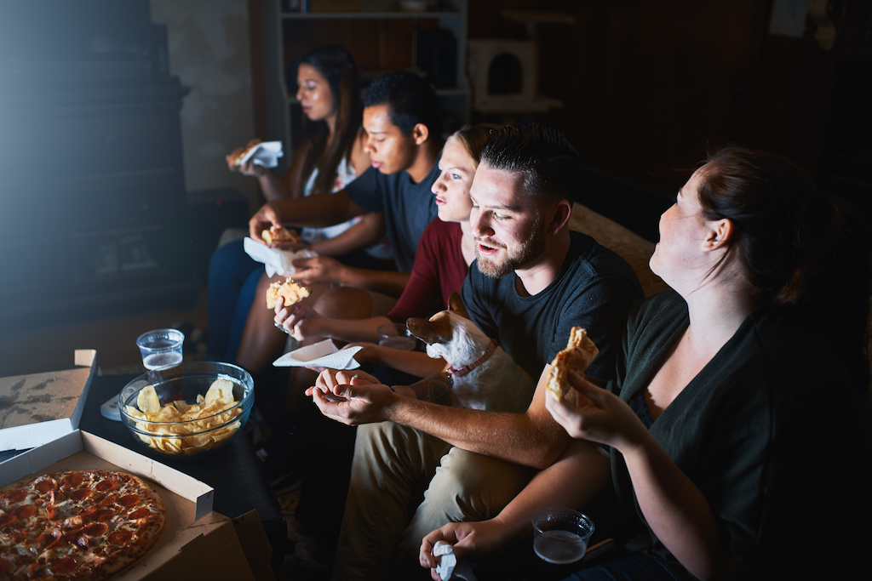
/ Why a Watch Party?
Trend of moving Remote (accelerated by COVID)
Interact in Real Time with Content
Business Use Cases
Live Sports
Live Concerts
Live Events
Micro Betting at these Events
Shopping Experiences
Red5 Pro Presentation - DigitalOcean
Infrared5 Confidential Information subject to Non-Disclosure Agreement by and between Infrared5 and Recipient

Slide 4
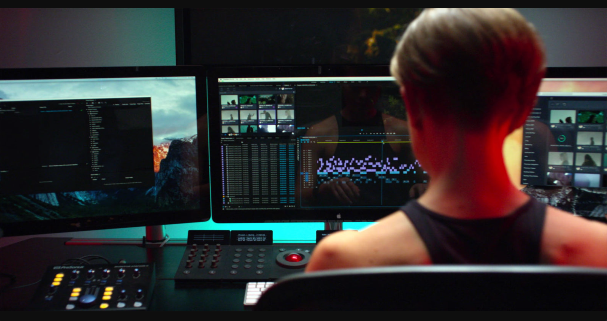
/ Interactivity
Audio Chat
Show/hide Cameras
Mute/unmute Mic
Gambling?
Purchasing?
Red5 Pro Presentation - DigitalOcean
Infrared5 Confidential Information subject to Non-Disclosure Agreement by and between Infrared5 and Recipient

Slide 5
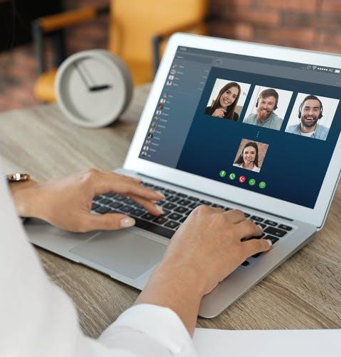
/ Reusing Existing Pieces
Publish/subscribe
Conference Example
Red5 Pro Presentation - DigitalOcean
Infrared5 Confidential Information subject to Non-Disclosure Agreement by and between Infrared5 and Recipient

Slide 6
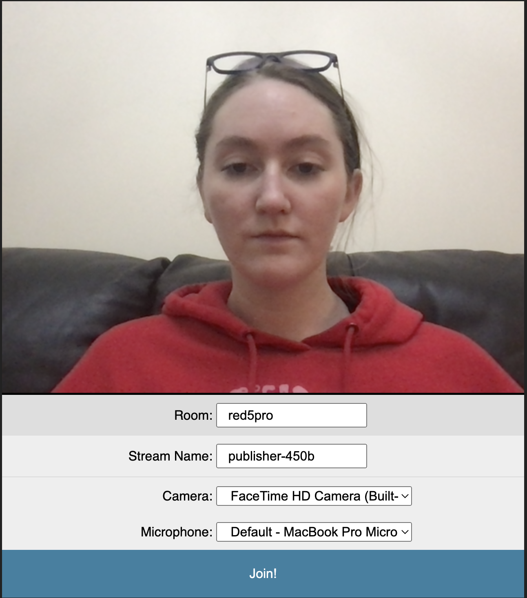
/ Building Blocks - Creating the Room
Create the Room
WebSocket Host
Parameters
Room Name
Stream Name
Red5 Pro Presentation - DigitalOcean
Infrared5 Confidential Information subject to Non-Disclosure Agreement by and between Infrared5 and Recipient
Notes:
https://github.com/red5pro/streaming-html5/tree/d26c549d55a6f080236b3a2eb6c1c3194b9f8ee3/src/page/test/conference
View our Conference example in the red5pro/streaming-html5 testbed!

Slide 7
/ Building Blocks - Joining a Room
Behind the Scenes
Shared Objects
User Perspective
Automatically Updates on Join/Exit
Red5 Pro Presentation - DigitalOcean
Infrared5 Confidential Information subject to Non-Disclosure Agreement by and between Infrared5 and Recipient

Slide 8
/ Adding the Main Program
Broadcast via RTMP
Subscribe via WebRTC
Autoplay on Join
Red5 Pro Presentation - DigitalOcean
Infrared5 Confidential Information subject to Non-Disclosure Agreement by and between Infrared5 and Recipient

Slide 9
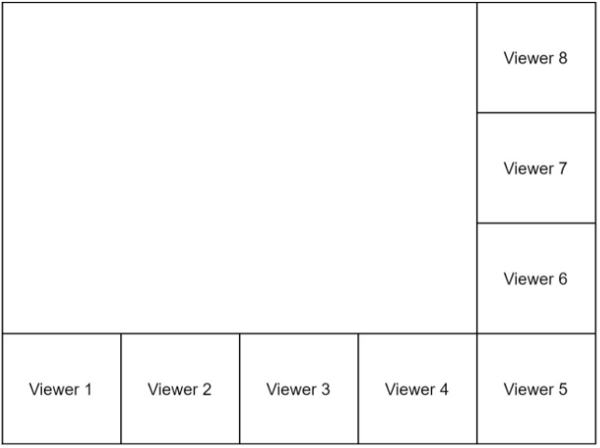
/ How’s it Look?
Red5 Pro Presentation - DigitalOcean
Demo!
Infrared5 Confidential Information subject to Non-Disclosure Agreement by and between Infrared5 and Recipient

Slide 10
/ Additional Features
Authentication
Interstitial
Red5 Pro Presentation - DigitalOcean
Infrared5 Confidential Information subject to Non-Disclosure Agreement by and between Infrared5 and Recipient
Notes:
Fully customizable!

